Slide 1
Supervisor update: Month 30
David Simons

Slide 2
Meeting plan
Review of timeline
Update on lab work and data collection
Update on progress Chapters 2, 3 and 4
Update on finances
Discussion around aims and objectives of the thesis and the narrative of the thesis (when Kate joins)
Current outline of the introduction

Slide 3
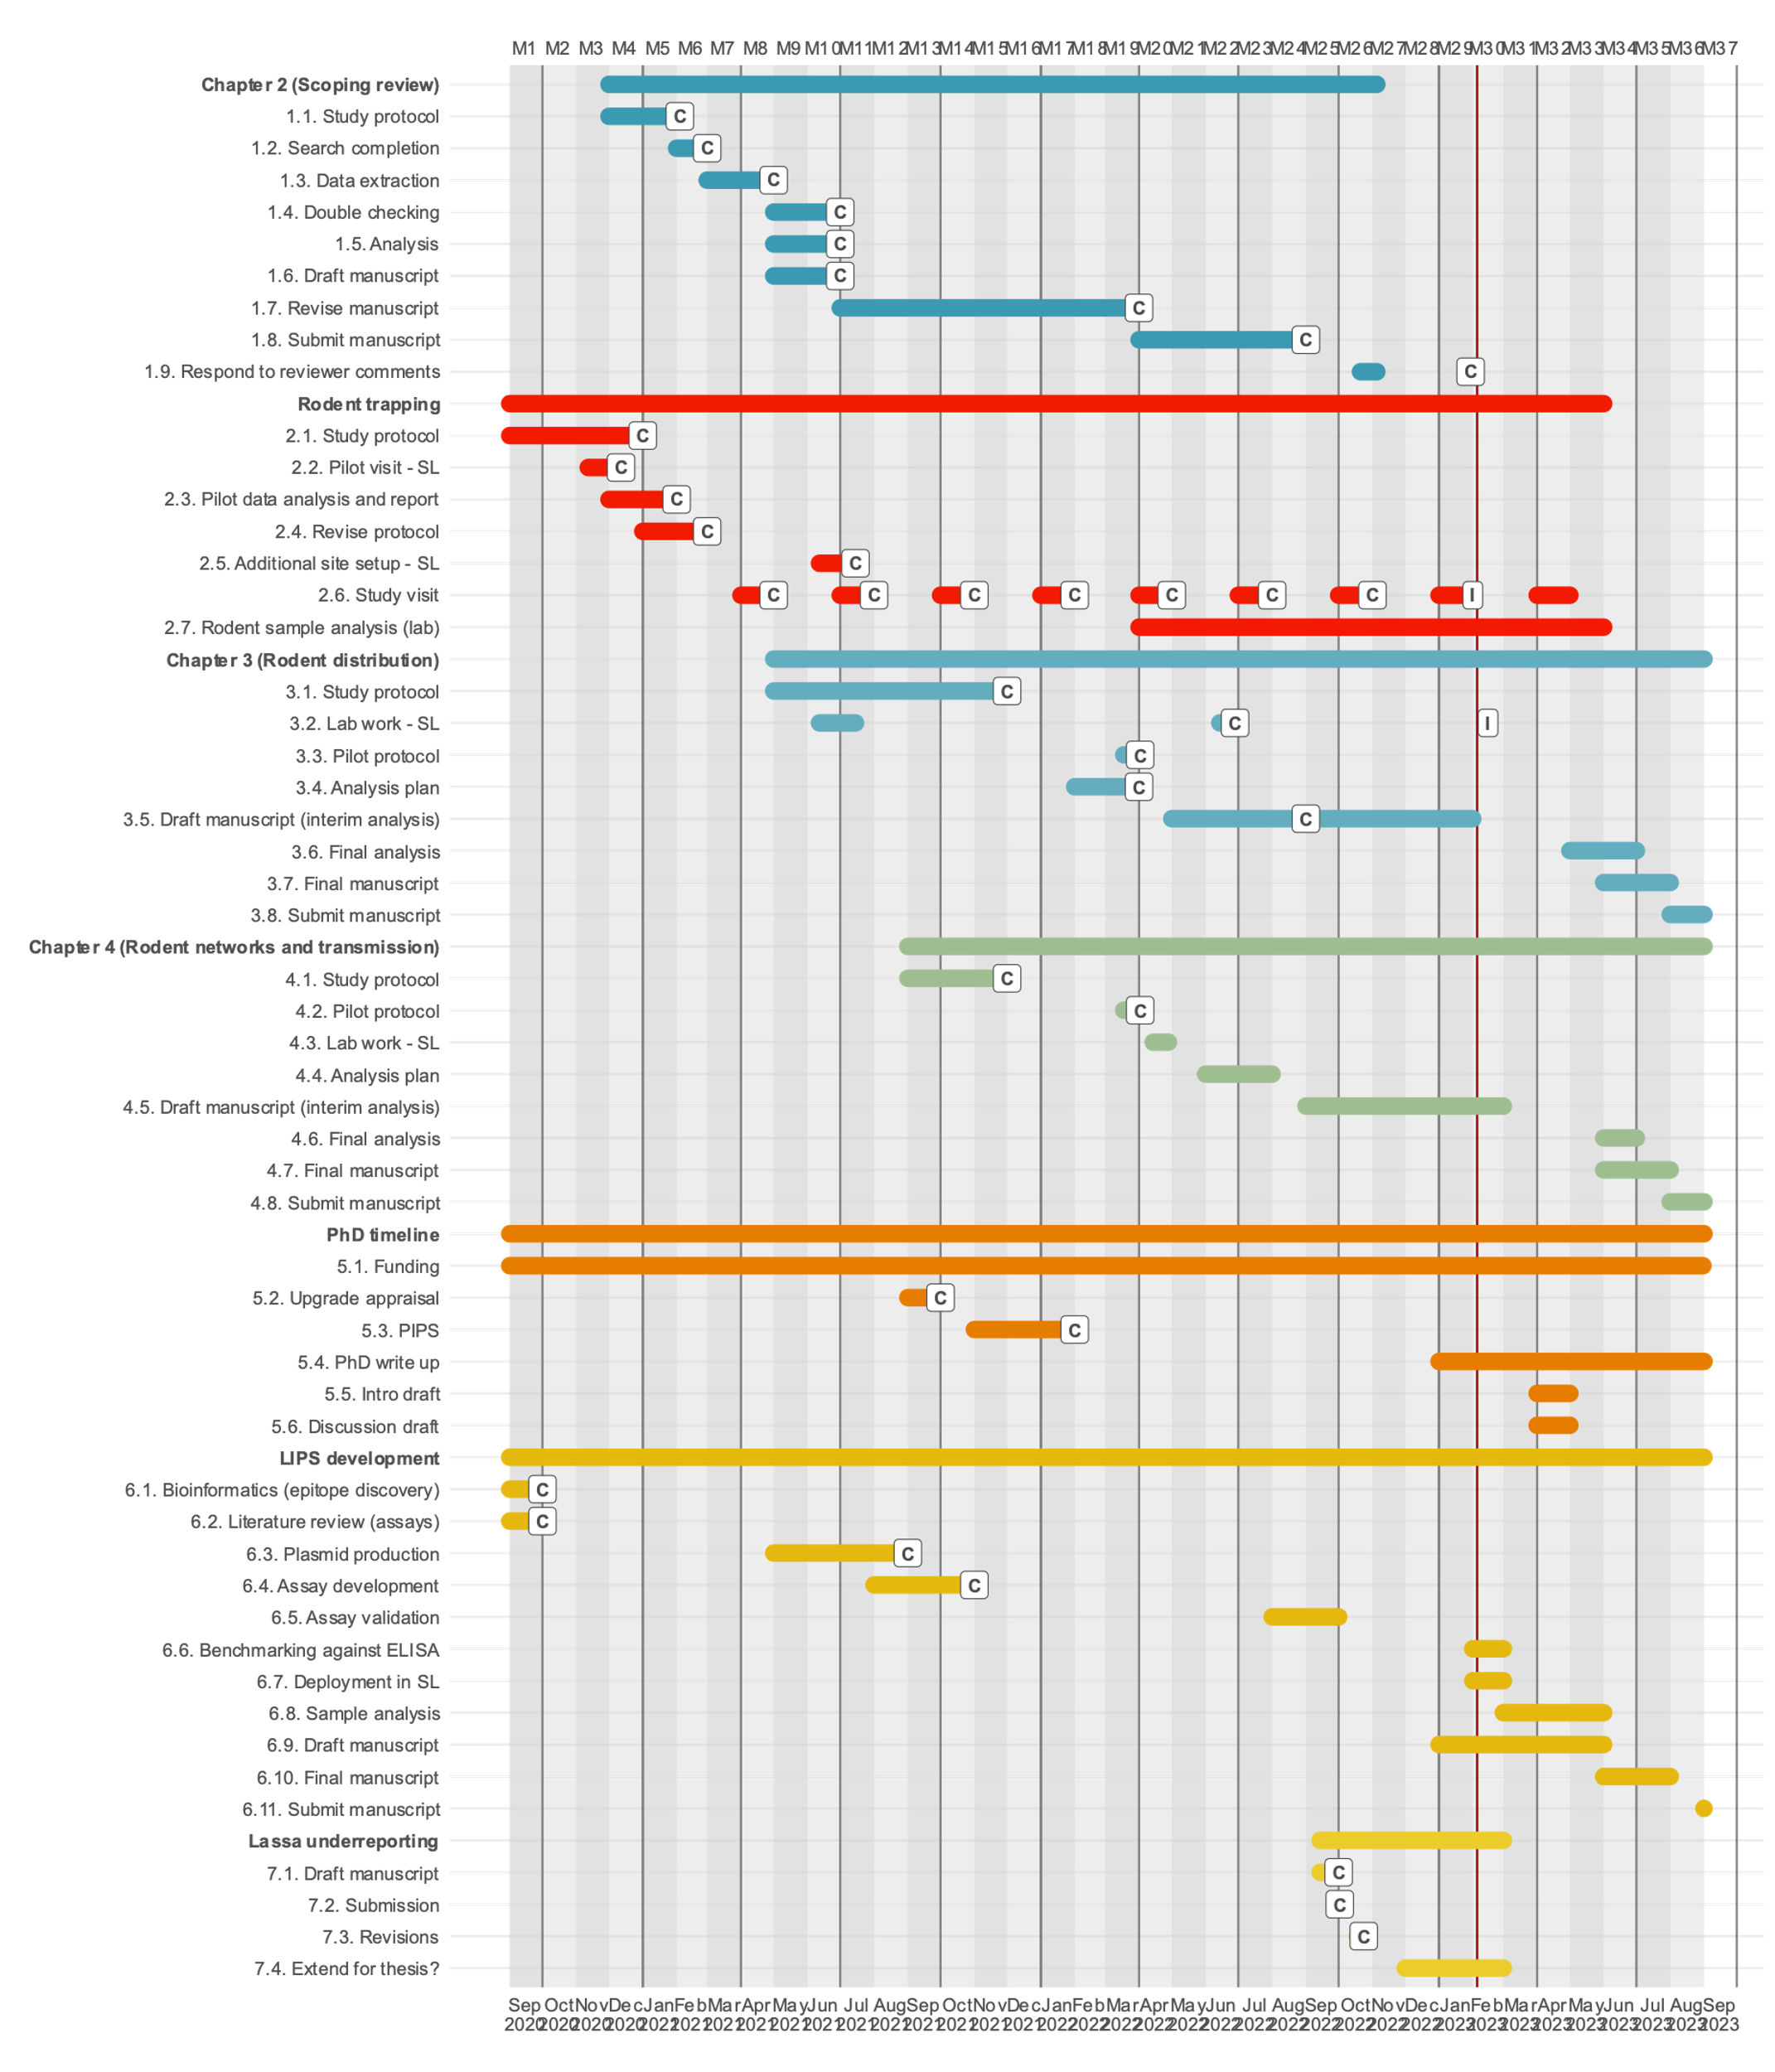

Slide 4
Rodent trapping
Team currently in the field for sessions 9 at Lalehun and Seilama and 7 at Lambayama and Baiama.
Will discuss with Rashid but most likely the final trapping session.
Awaiting finalised data on trapping for this and previous visit but will be able to collect it all before I leave.

Slide 5
Lab work
PCR reagents en route, sufficient material to complete DNA extraction and amplification of all expected rodents.
Sequencing has been paid for and samples will be sent in batches to ensure that sequences that fail can be re-run.
Plan for all sequences to be completed by May.
The final analysis for chapter 3 will then be run on this data but I do not expect any substantial changes.
We have purchased ELISA plates to complete the antibody testing of all available samples. The frozen reagents have been shipped. Chilled reagents are still in the UK, I have received a quote from Biocare for £3,500, Debby is checking with her team whether they have a shipment going out soon.
Ideally ELISA will be completed around similar dates, but is quick to run and so as long as arrives by end of April should be ok.

Slide 6
PhD Progress:
Richard has submitted the examiner forms to the RVC
Current plan is for submission around July, scope to be pushed back as funding extends until September

Slide 7
Chapter 2
Published at PLOS NTD
Proofs submitted
Will submit the underlying data to GBIF for inclusion in their repository, they also have a journal so an additional publication can arise from this work, should be no article charges.

Slide 8
Chapter 3
Final draft shared in January
Feed in final rodent data and finalise manuscript around April/May
First, what is the diversity of rodent communities in varied landuse types in Eastern Sierra Leone?
Second, how do patterns of landuse affect the occupancy of M. natalensis and other sympatric rodents?
Third, is there evidence that the local spatial distribution of M. natalensis is regulated by biotic interactions with co-occurring species?

Slide 9
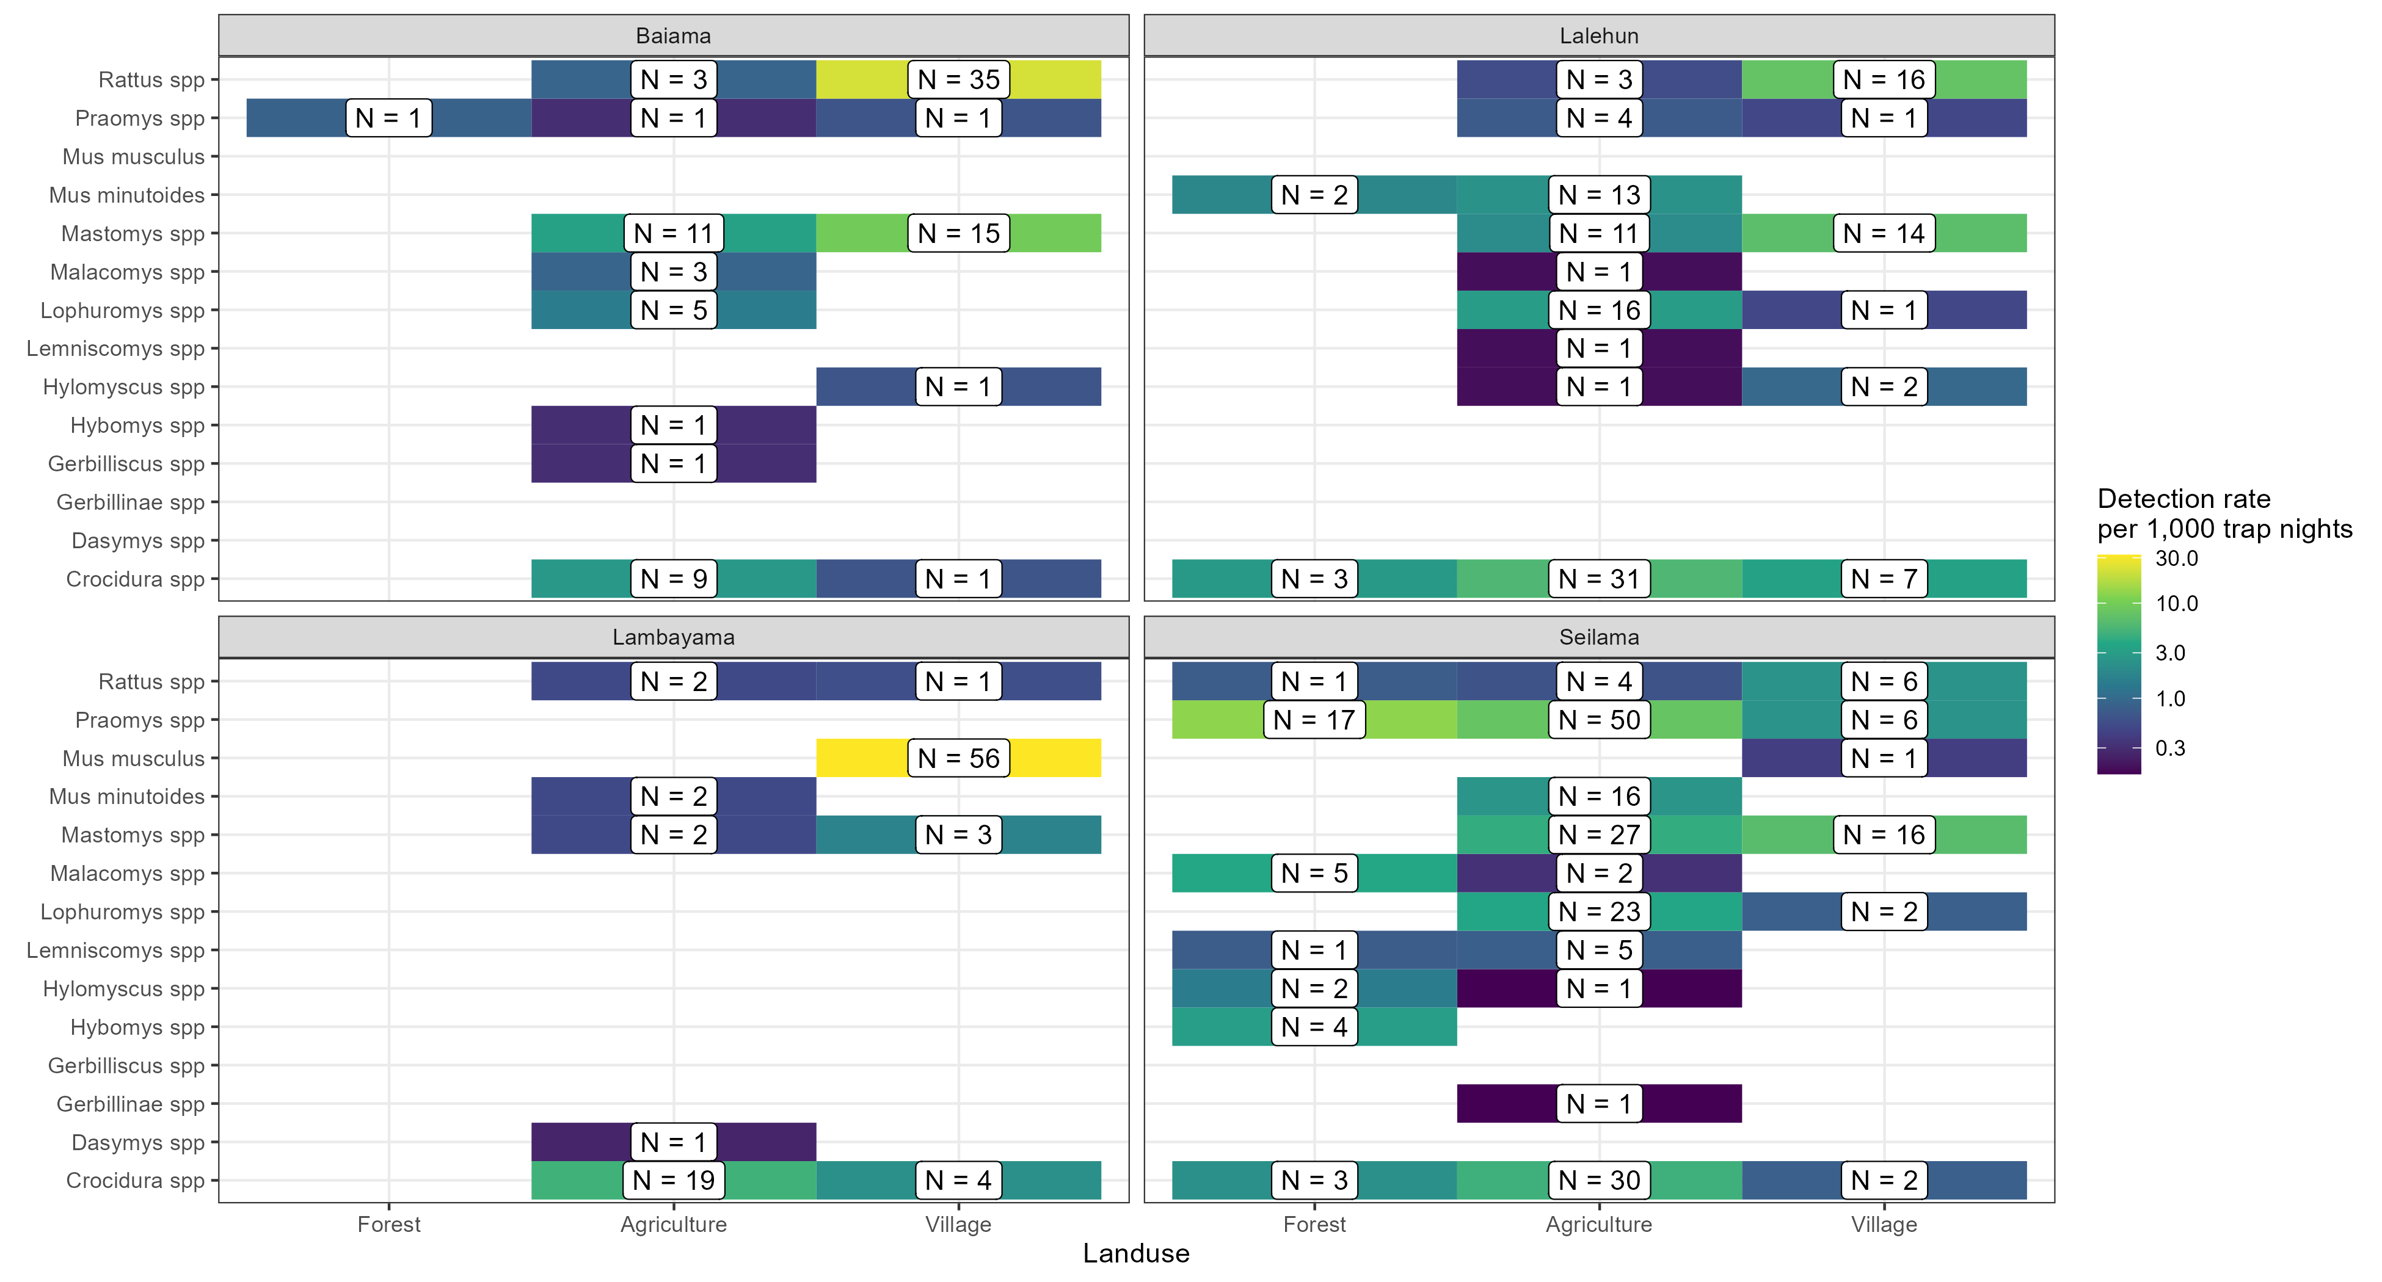
Chapter 3 – Results (1)

Slide 10
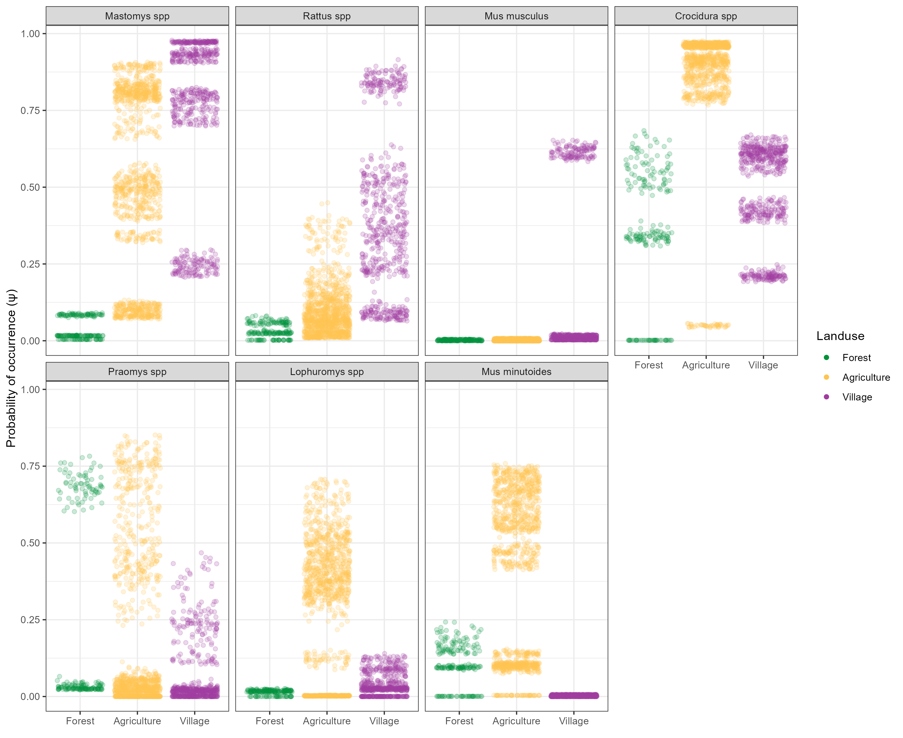
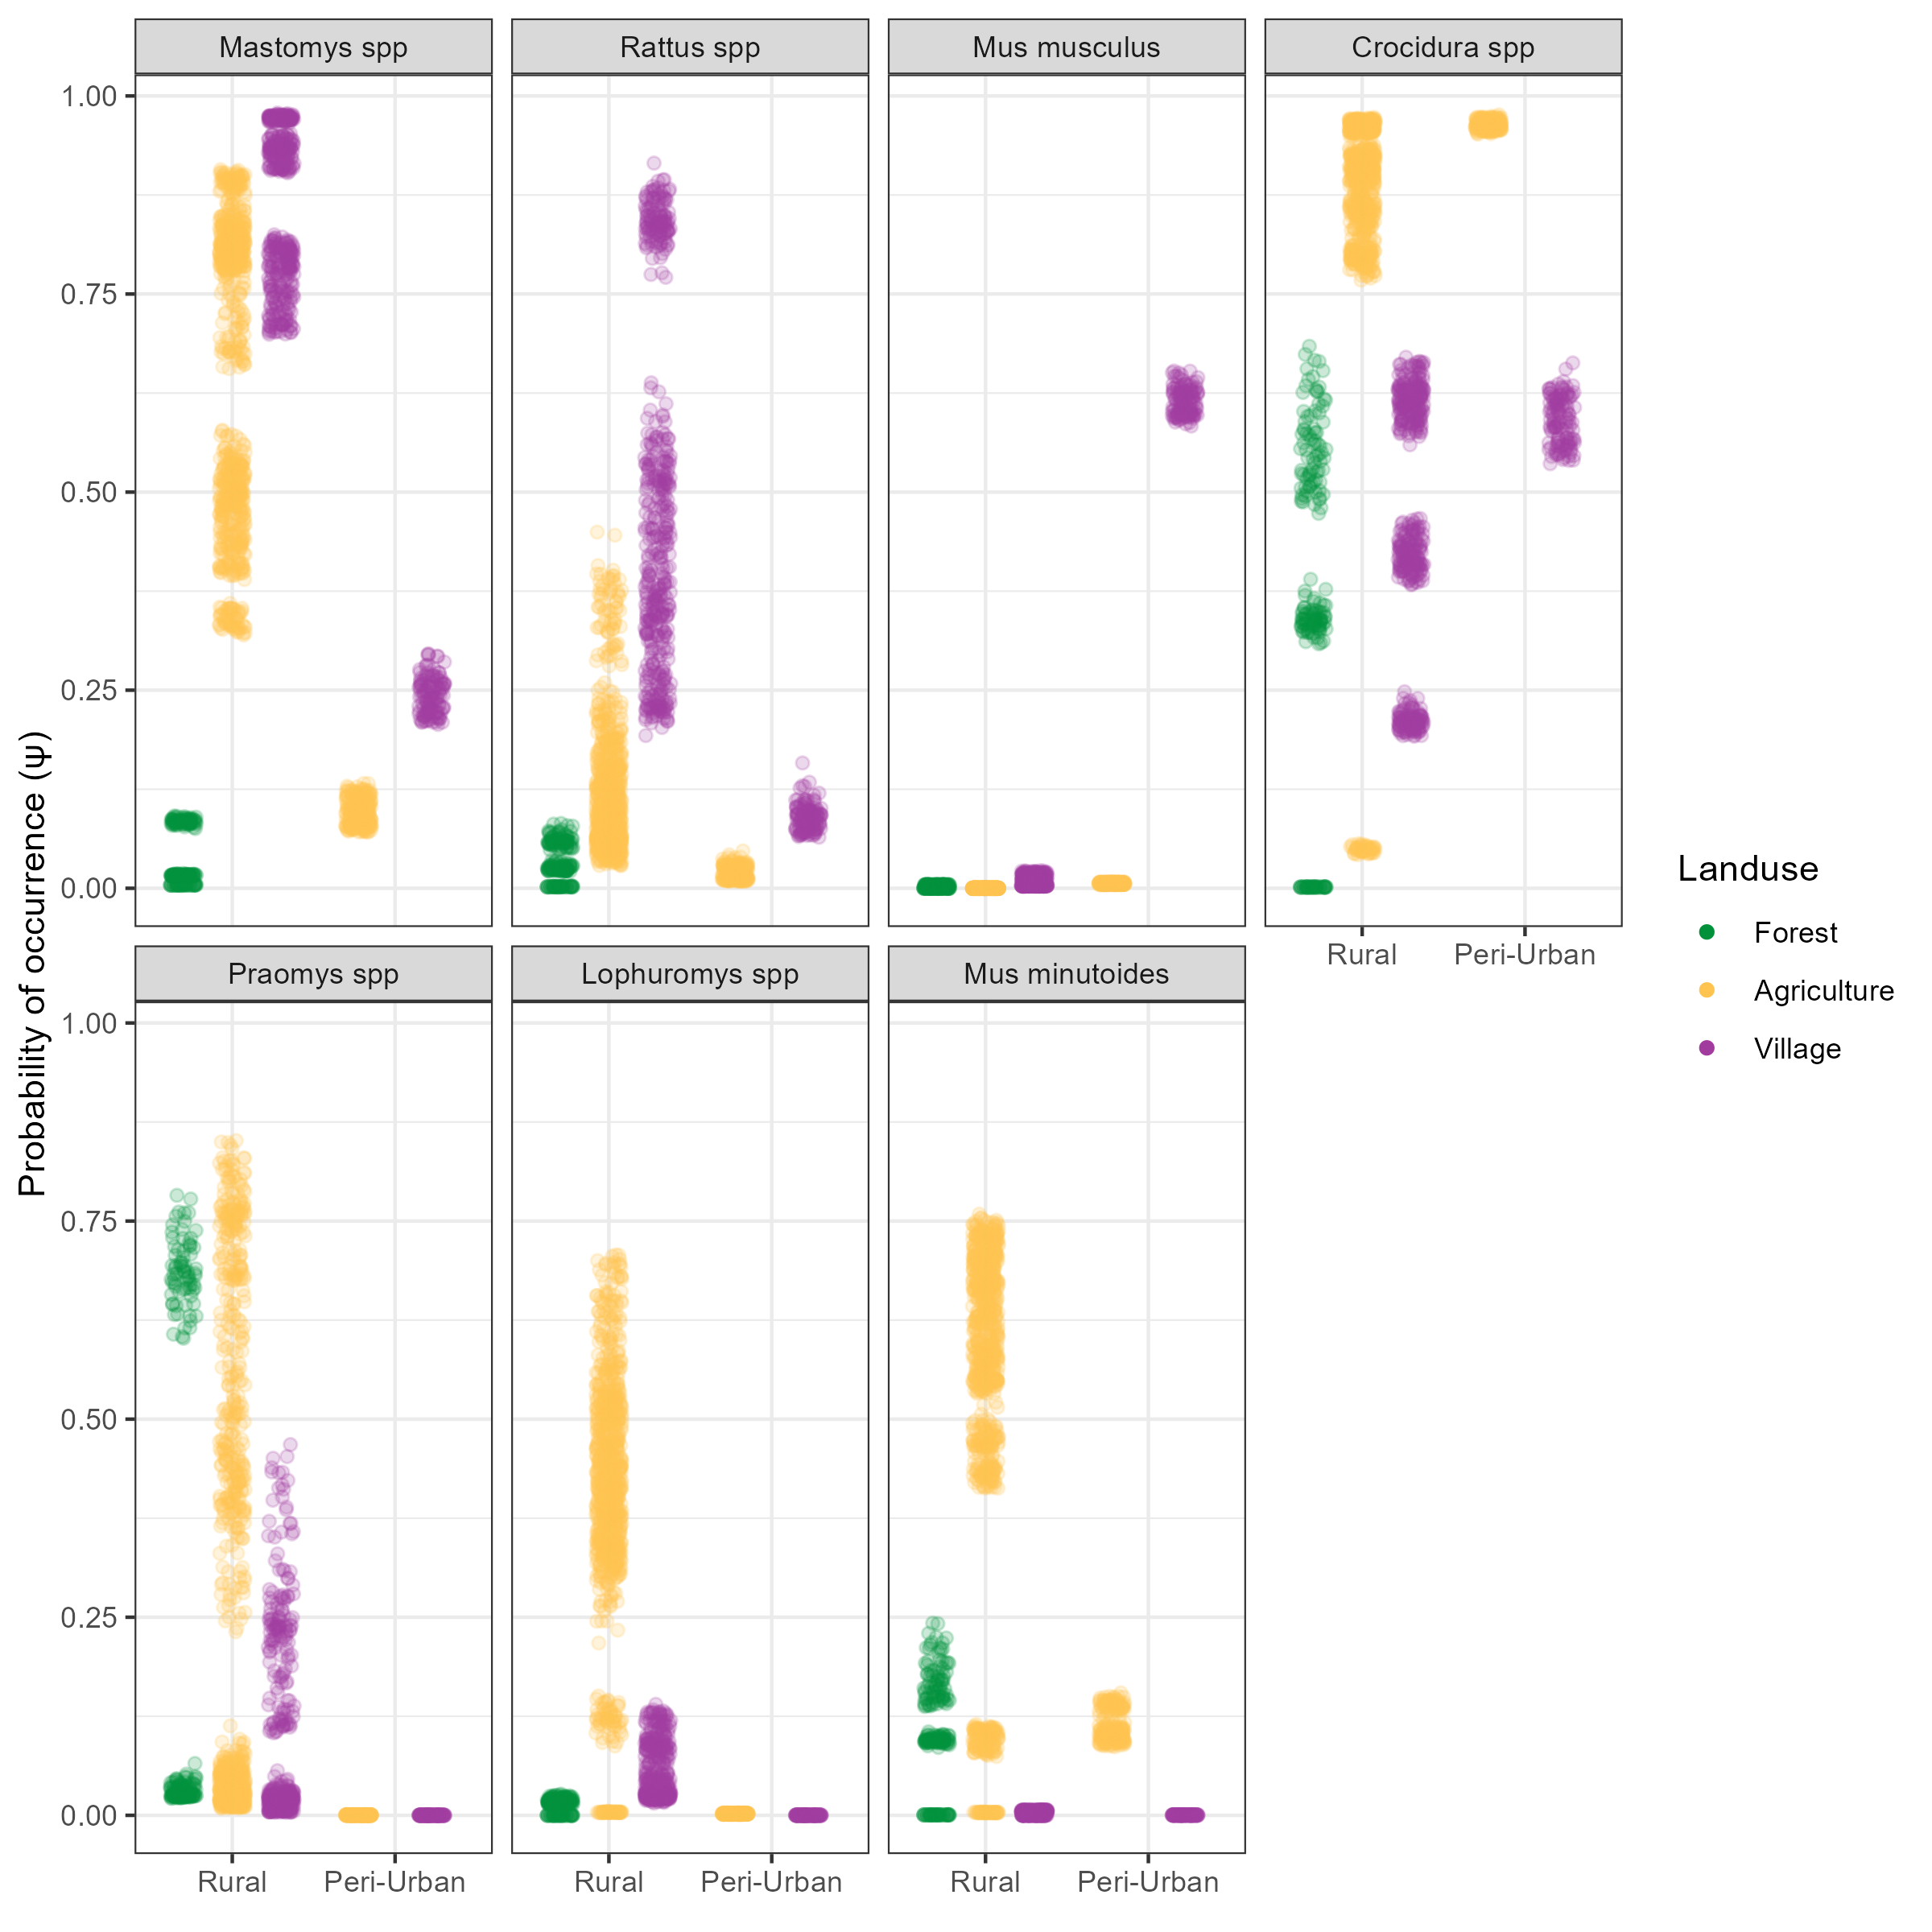
Chapter 3 – Results (2)

Slide 11
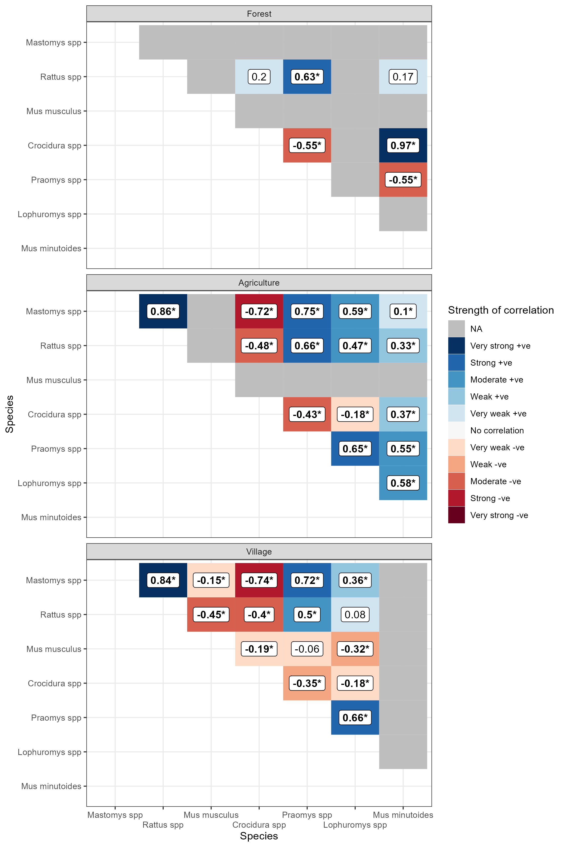
Chapter 3 – Results (3)
Notes:
Correlation is describing the trend but not the absolute change.

Slide 12
Chapter 4
Produce potential contact networks of rodents in a Lassa fever endemic region.
First, are rodent contact networks densest in areas of human habitation?
Second, how do contact networks vary in different landuse settings?
Third, do Mastomys natalensis contact rates among individuals of the same species and other species occur at different rates?

Slide 13
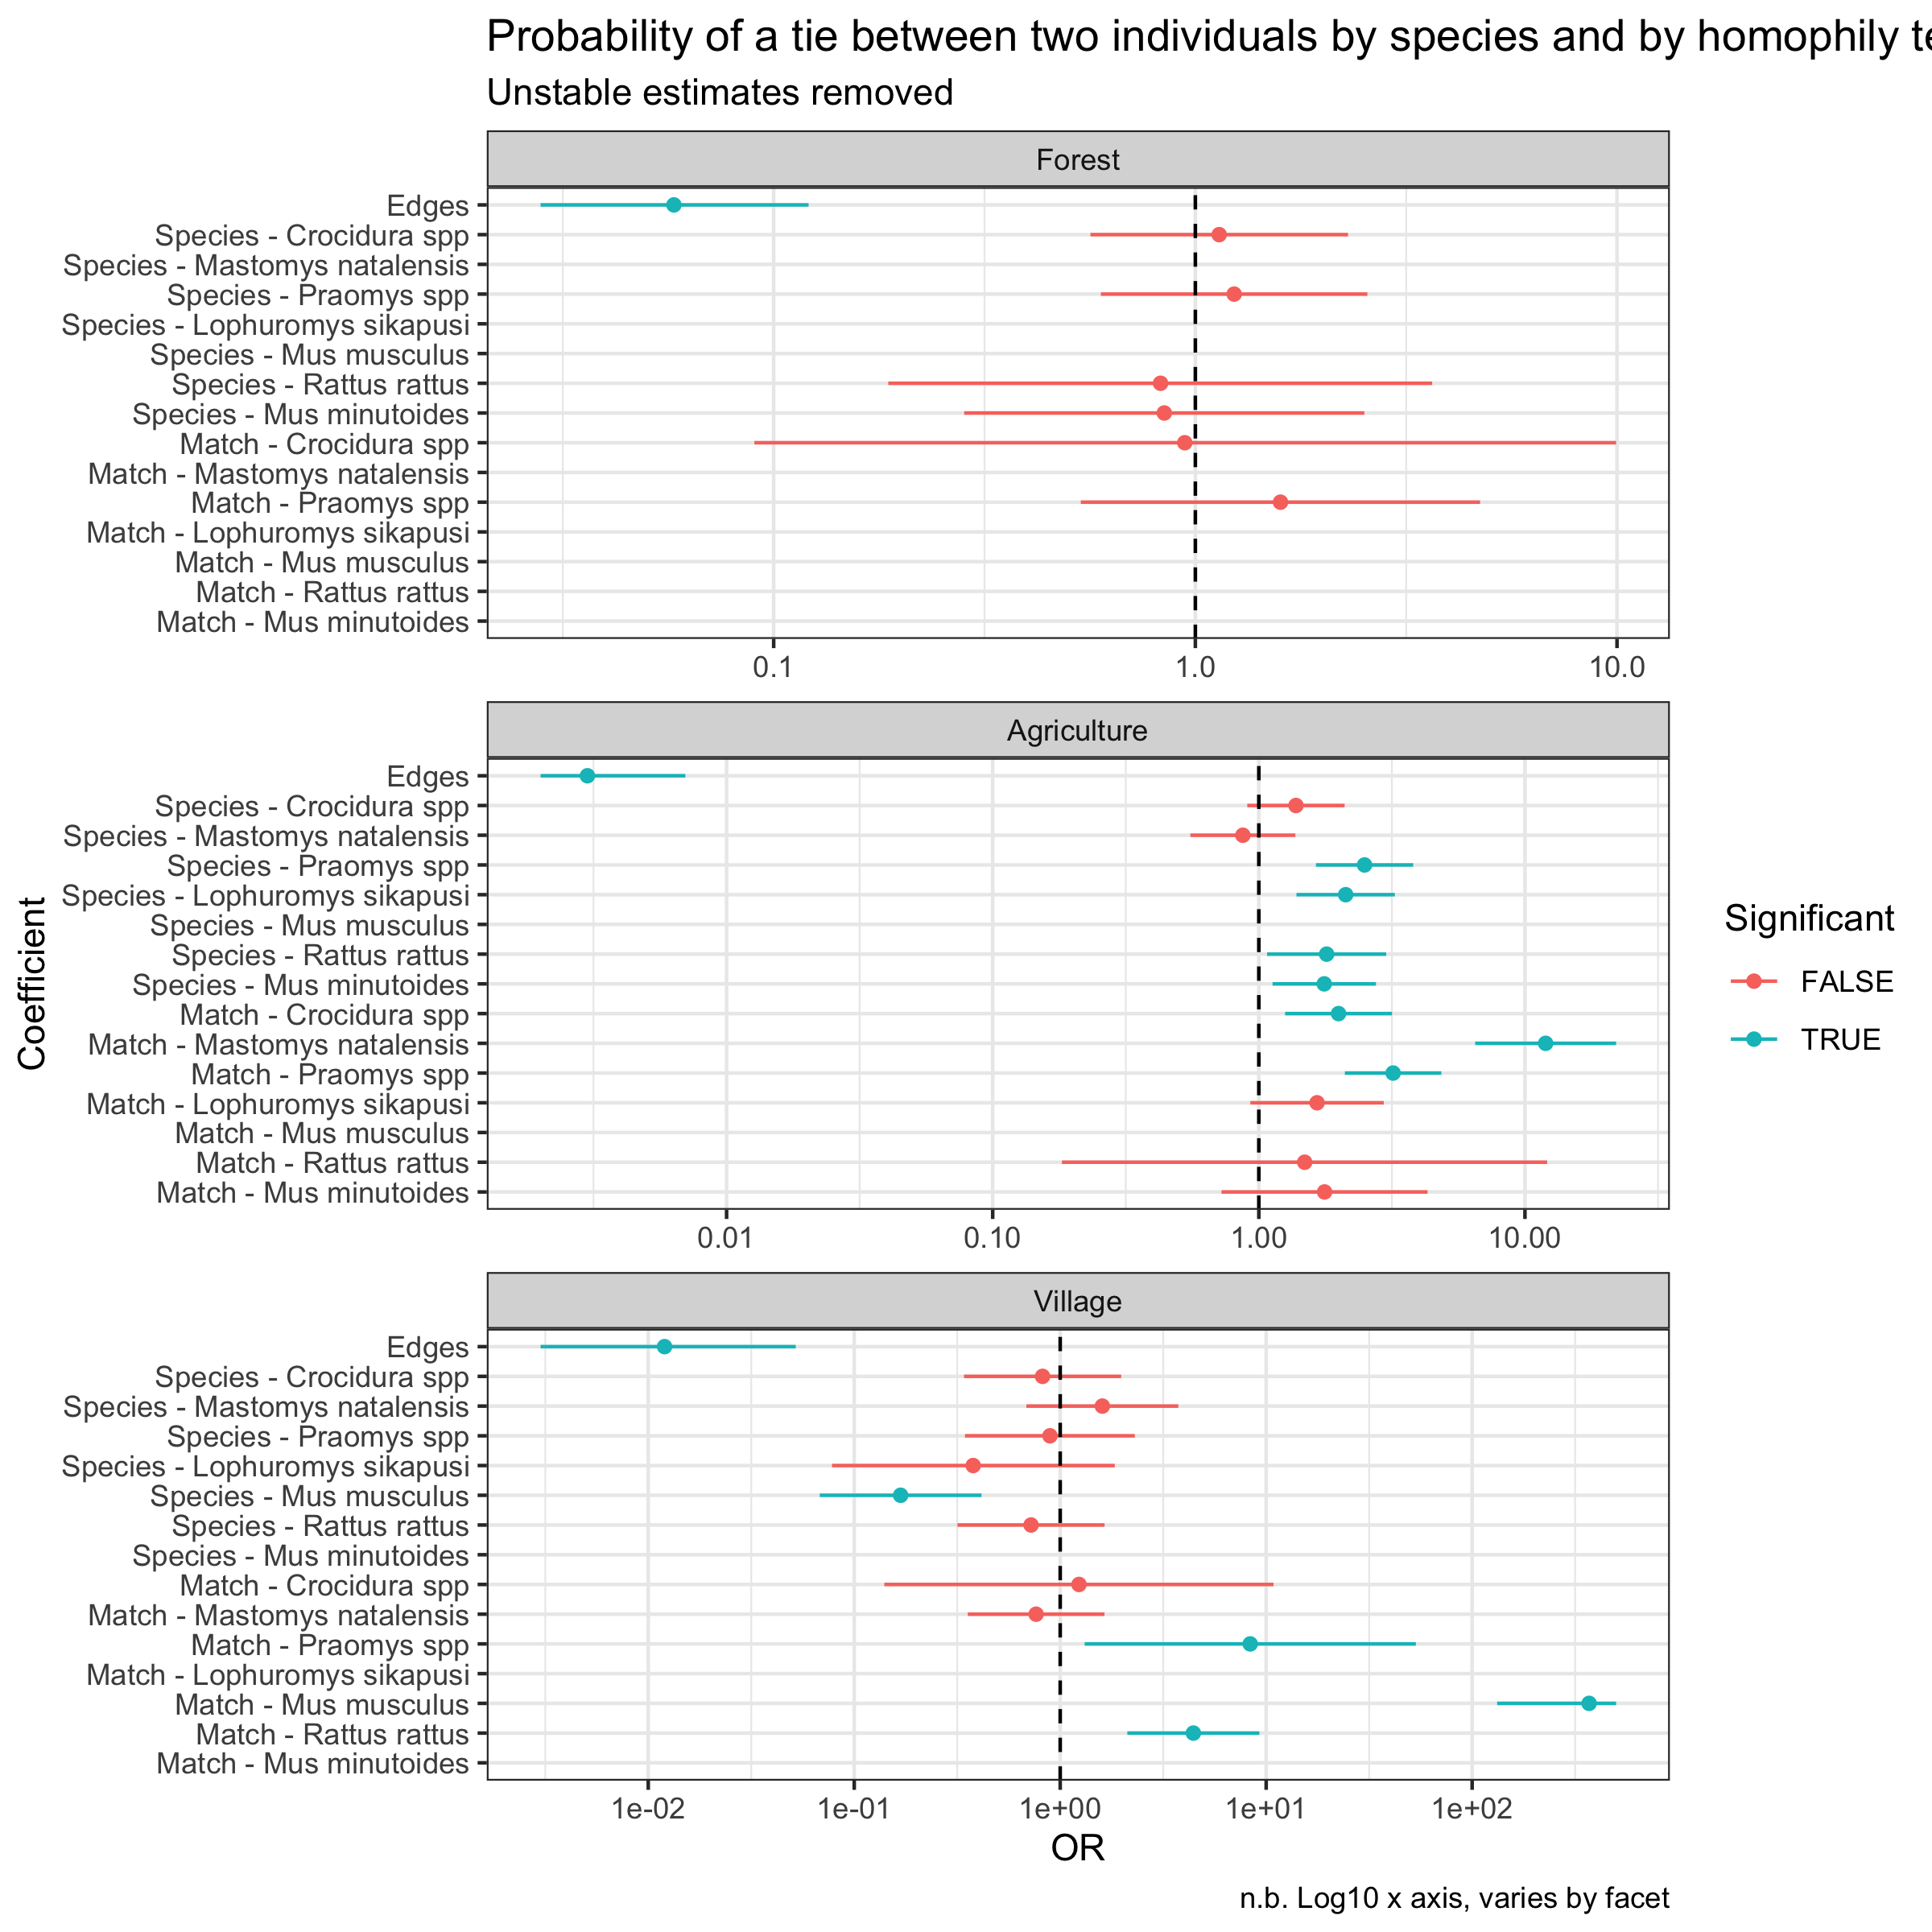
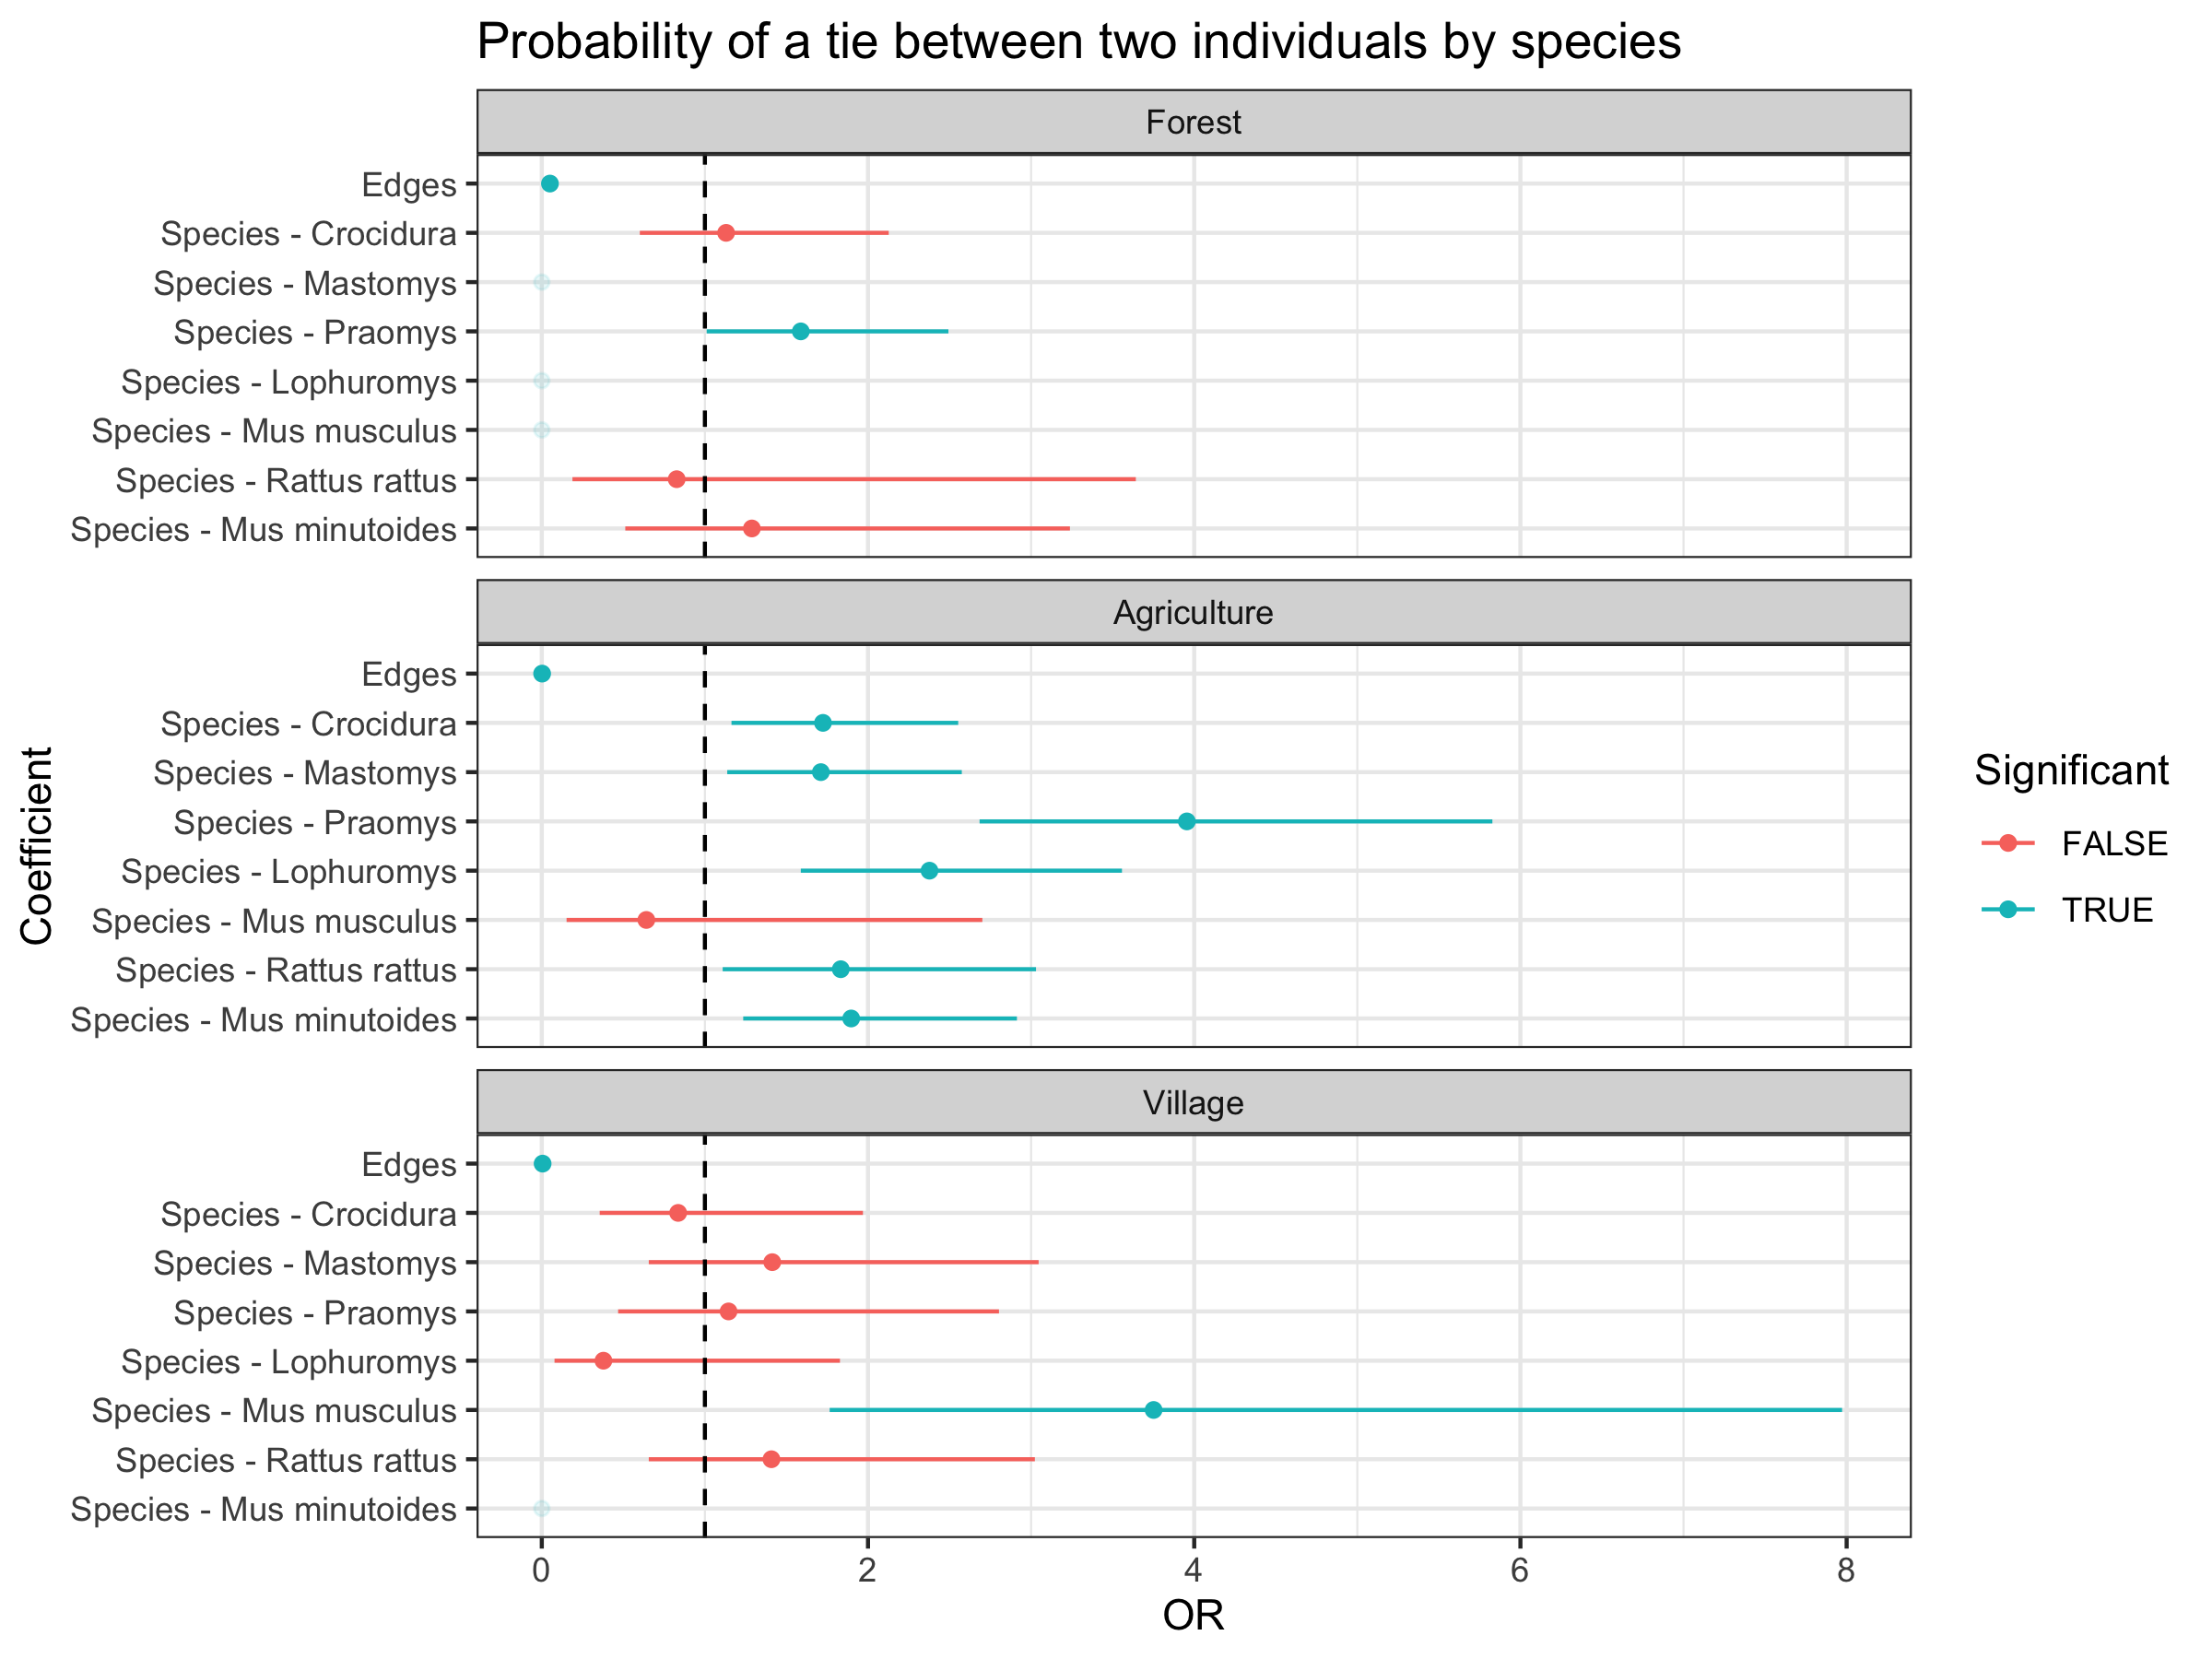
Chapter 4

Slide 14
Immediate next steps
Chapter 3:
Await final species level data and recompile
Incorporate supervisors comments
Chapter 4:
Finalise analysis plan
Write up draft for supervisors prior to next meeting
Further ELISA kits/reagents to SL

Slide 15
Thesis Research Questions
Overarching question is about the role of the natural environment on rodent ecology and the impact this may have on the risk of Lassa fever spillover events into human populations in endemic areas.
The first study was designed to understand the current scope of studies of rodent ecology for zoonotic diseases in West Africa. We asked whether current studies are biased towards particular geographic locations, rodent host species and pathogens.
The second study asked whether rodents in a Lassa fever endemic region are distributed along landuse gradients and whether all settings would be likely to contribute the same risk of Lassa fever spillover.
The third study asked whether rodents in these settings are equally likely to come into contact with rodents of the same or different species. This could be important when trying to understand how LASV transmits among these rodent networks.

Slide 16
Thesis aims
The first aim of this thesis is to synthesise information on rodent and pathogen sampling from rodent trapping studies across West Africa to quantify the biases in currently available data. I hypothesise that rodent and pathogen sampling is spatially and taxonomically biased which will have implications on inference able to be drawn from currently available data about the hazard of zoonosis spillover risk across the region. I test the null hypothesis that rodent and pathogen sampling is conducted randomly in space across the region and propose an alternative hypothesis that rodent sampling is spatially clustered. I describe the occurrence of known and potential hosts of zoonosis from presence and absence data and compare this to currently available resources and produce host-pathogen associations from these data.
The second aim of this thesis is to investigate the association of rodent species diversity and landuse type in a Lassa fever endemic region of Eastern Sierra Leone. I hypothesise that known hosts of Lassa fever occur preferentially in human dominated landuse types with higher rodent species diversity in less disturbed landuse types. I test the null hypothesis that the probability of occurrence of rodent species does not change across landuse types and propose an alternative hypothesis that hosts of Lassa fever have a higher probability of occurrence in human dominated landuse types.
The final aim of this thesis is to recreate Lassa fever transmission networks among rodent species. Using rodent trapping data we construct potential contact networks of the resident rodent species and calculate the probability of contact among and between individuals of different species. We test the null hypothesis that rodent contacts are not structured and that within a landuse setting all species are equally likely to come into contact with each and propose an alternative hypothesis that rodent contacts are structured with individuals more likely to come into contact with members of the same species.

Slide 17
Potential issues and mitigations
Chapter 2:
Nil
Chapter 3:
Issue 1: Sequencing of processed DNA
Should be minimal risk
Chapter 4:
Issue 1: Low seroprevalence may limit between species or between habitat inferential statistics (i.e. low statistical power)
Mitigation: May have to limit to description of risk of Lassa mammarenavirus infection

